Slide 1
SAR Image Generation based on Generative Adversarial Network and Target Characteristics

Slide 2
Aim of Project
The price of acquiring Synthetic Aperture Radar (SAR) images is high. Hence, SAR image samples are scarce, which leads to poor model performance when combining SAR images with machine learning. To mitigate the impact of this issue, synthetic (or “fake”) SAR images are generated using Generative Adversarial Networks (GAN) to achieve data augmentation.
Key Words: Machine Learning, Generative Deep Learning, GAN, SAR Imagery, Image Synthesis, Image Generation

Slide 3
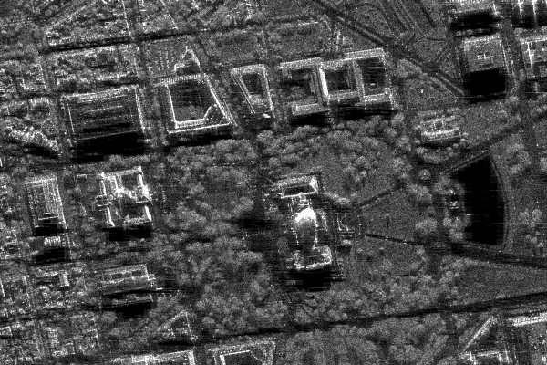
Synthetic Aperture Radar (SAR)
A type of imaging radar
Can achieve ultra-high resolution
Available independent of weather conditions, day and night
Applied in geoscience, research on climate change, environmental system monitoring, 2D/3D mapping, change detection…
SAR image of Washington, D.C., figure source: Sandia National Laboratories

Slide 4
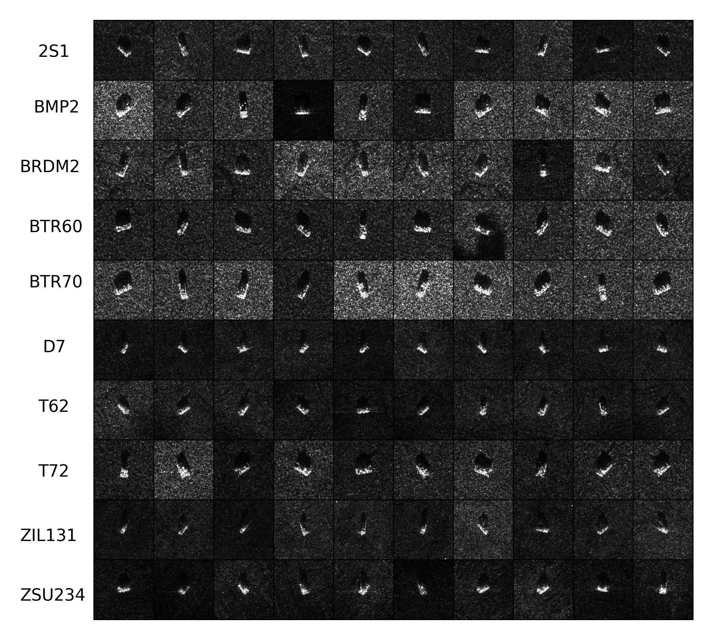
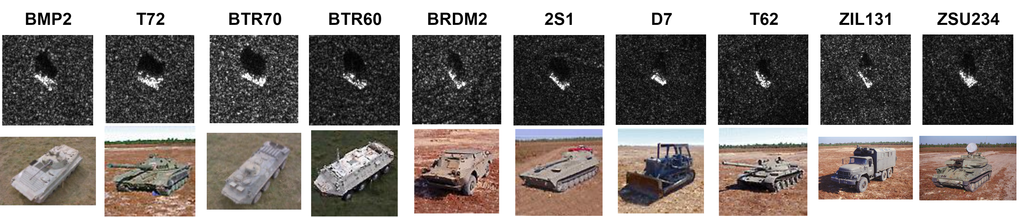
MSTAR Dataset
Name of Class | Train Dataset | Test Dataset
2S1 | 299 | 274
BMP2 | 232 | 196
BRDM2 | 298 | 275
BTR60 | 256 | 195
BTR70 | 233 | 196
D7 | 299 | 274
T62 | 299 | 273
T72 | 232 | 196
ZIL131 | 299 | 274
ZSU234 | 299 | 274
Total | 2746 | 2426
The number of samples in MSTAR dataset

Slide 5
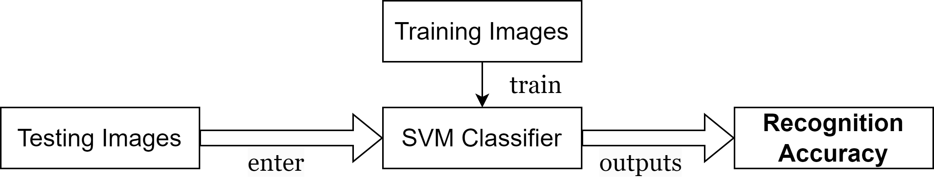
Target Recognition Experiment
Ideal situation: Training Images contain all the images in trainset of MSTAR, about 275 images of each class
Recognition Accuracy = 94.27%
Practical situation: Training Images contain only 10 images of each class
Recognition Accuracy = 44.39%

Slide 6
Generative Adversarial Networks (GAN)
Generative Adversarial Network (GAN) is a type of deep learning model that consists of two competing neural networks: a Generator and a Discriminator. The Generator creates new, synthetic data that is meant to resemble real data, while the Discriminator tries to determine which data is real and which is synthetic. These two networks are trained simultaneously, with the Generator trying to produce data that can fool the Discriminator, and the Discriminator trying to correctly identify the real data from the synthetic data. The ideal result is a Generator that can produce data that is very similar to the real ones.

Slide 7
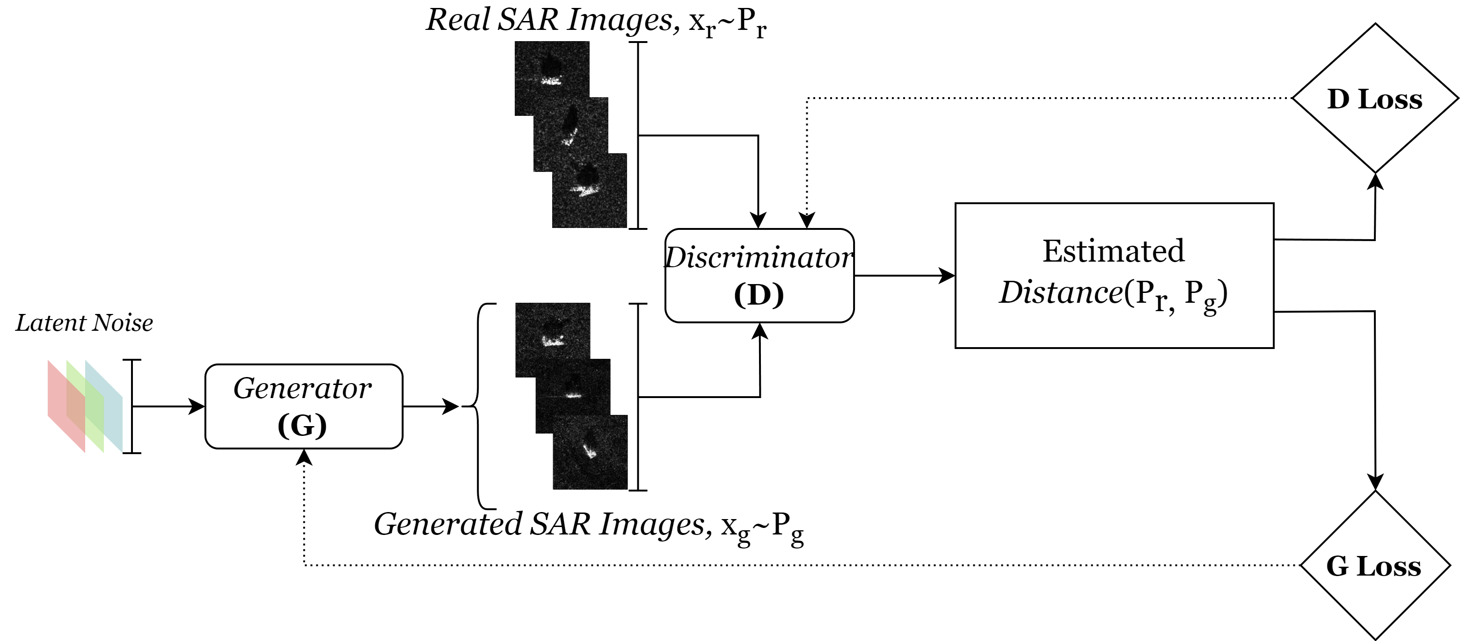
Generative Adversarial Networks (GAN)

Slide 8
Implemented GANs in This Project
DCGAN
WGAN-GP
WGAN-DIV
SNGAN
SNGAN(Enhanced)
VAE-GAN
Deep Convolutional GAN
Cross-Entropy as Distance function
Wasserstein GAN with Gradient Penalty
Wasserstein Distance as Distance function
Gradient Penalty, Guarantee the training stability in Discriminator
Wasserstein Divergence GAN
Wasserstein Distance + Gradient Penalty → Wasserstein Divergence
Spectrally Normalized GAN
Spectral Normalization, Guarantee the training stability in Discriminator
An improved version of SNGAN
ResNet in Generator, Self-Attention in Discriminator
Variational Auto-Encoder (VAE) Generative Adversarial Network (GAN)
a hybrid model: VAE+GAN

Slide 9
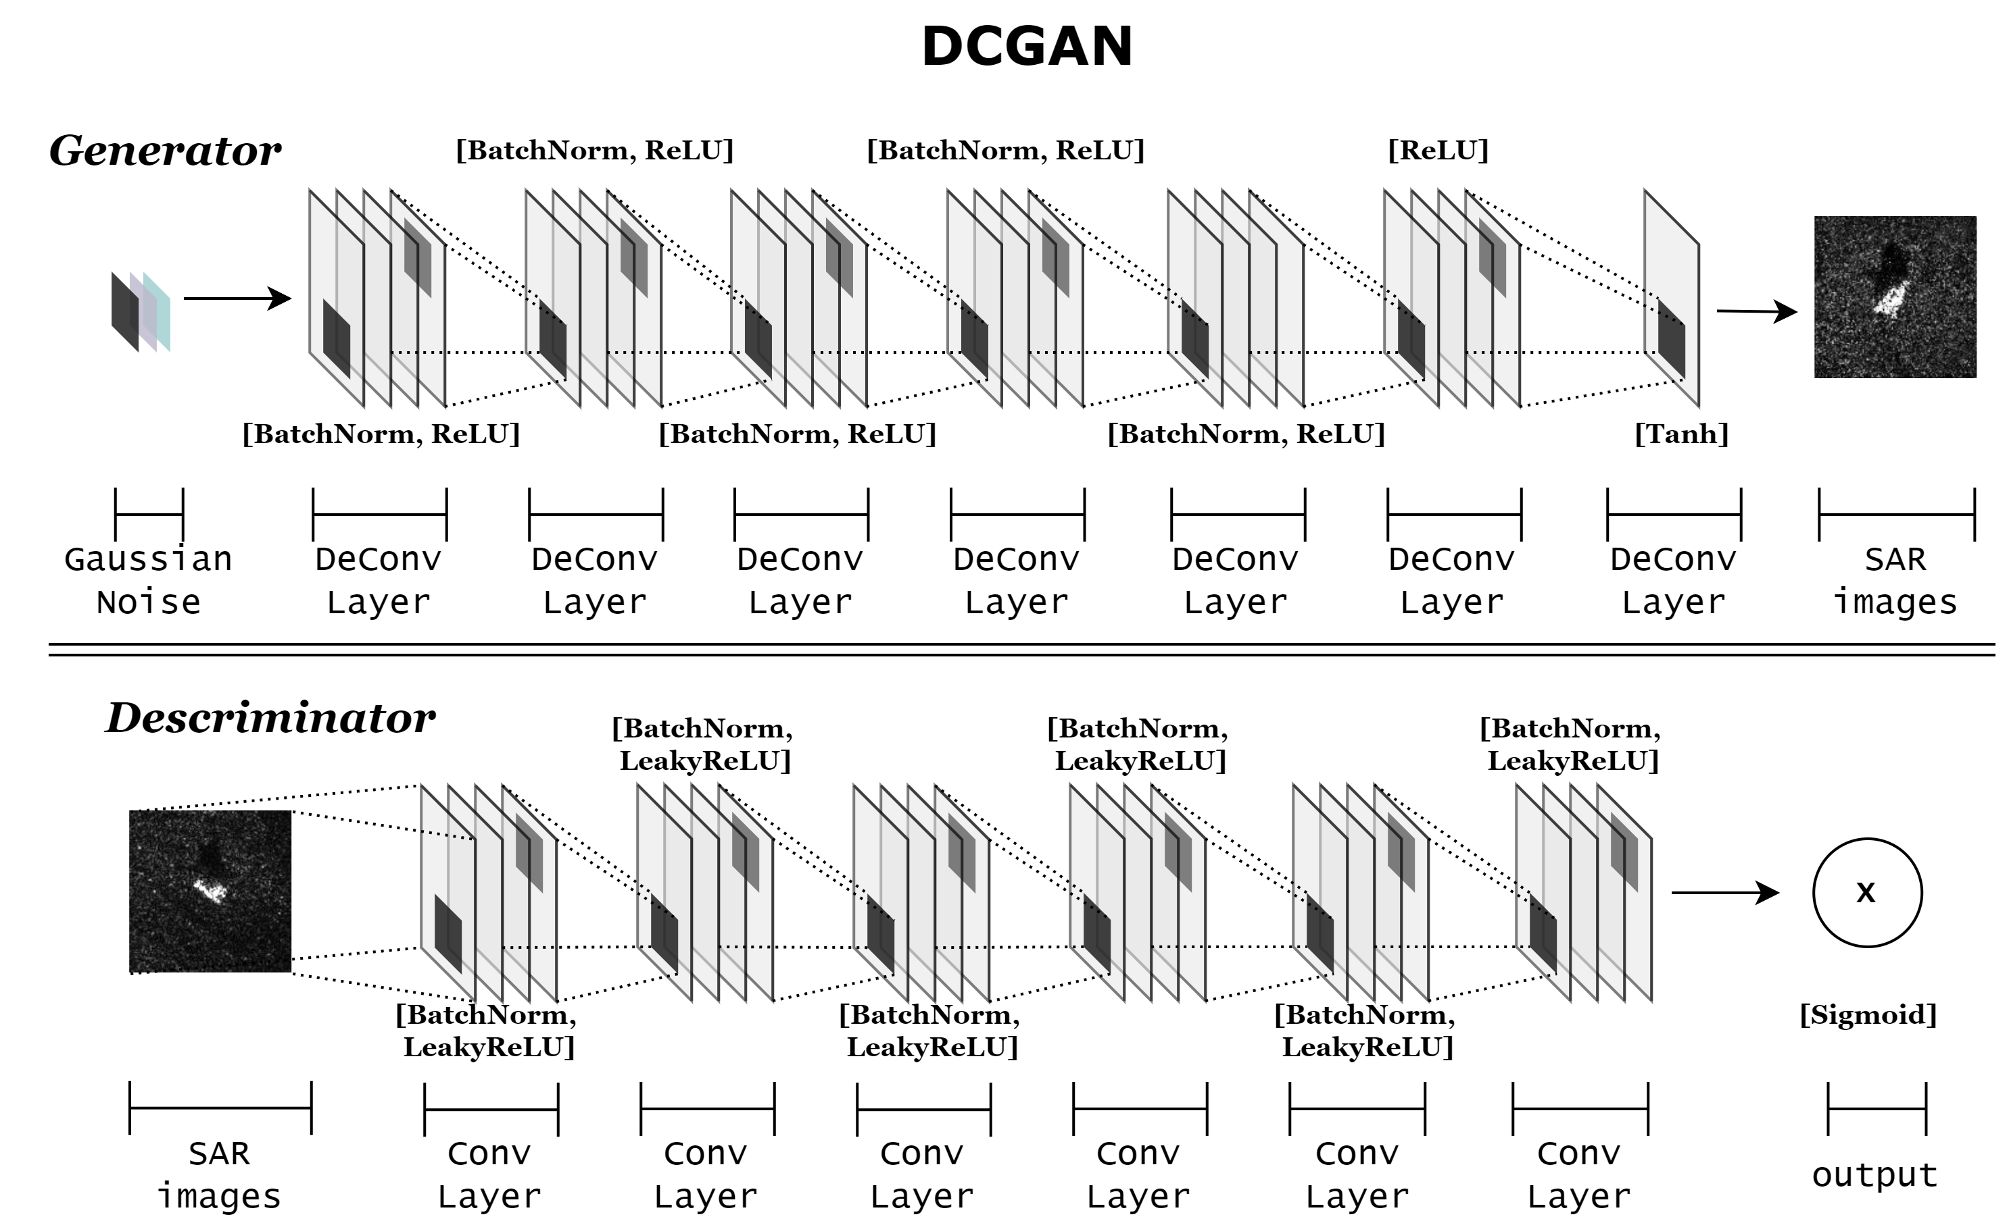

Slide 10
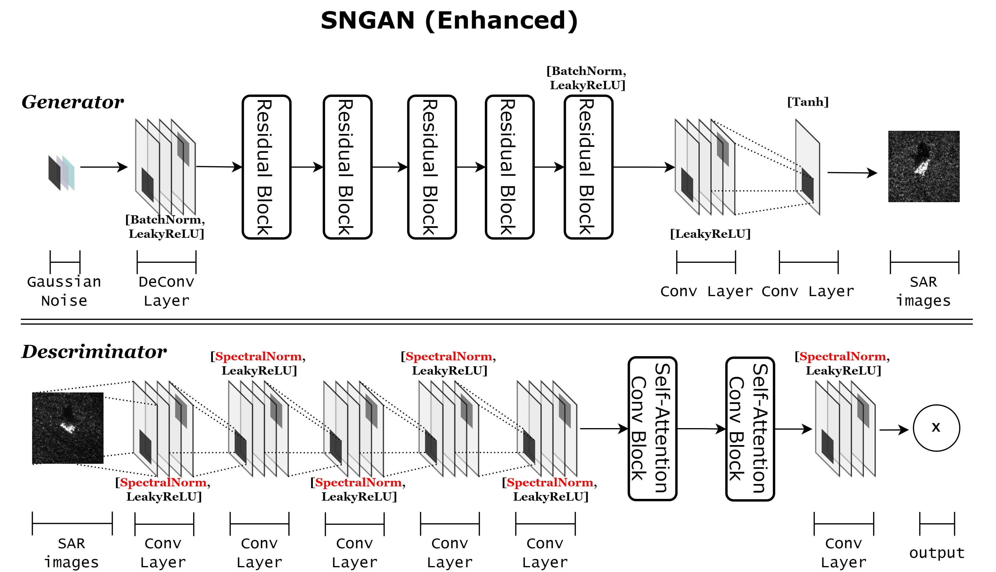

Slide 11
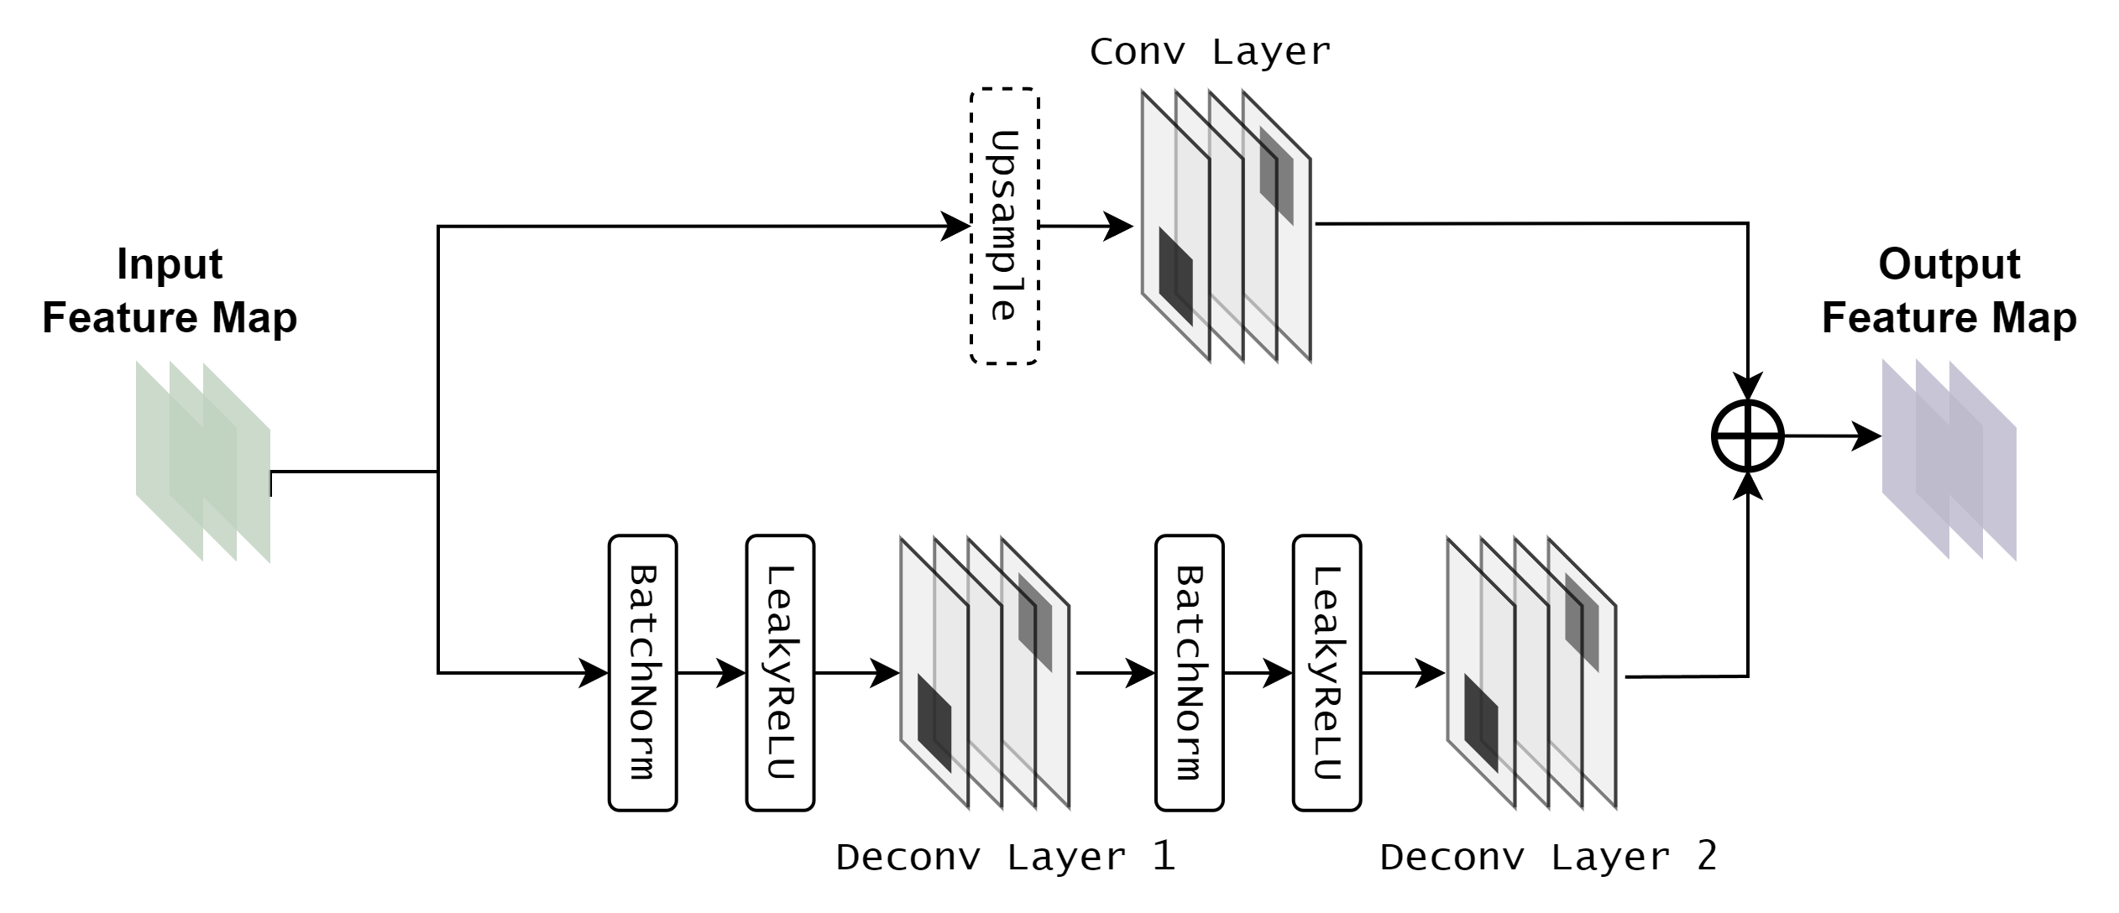
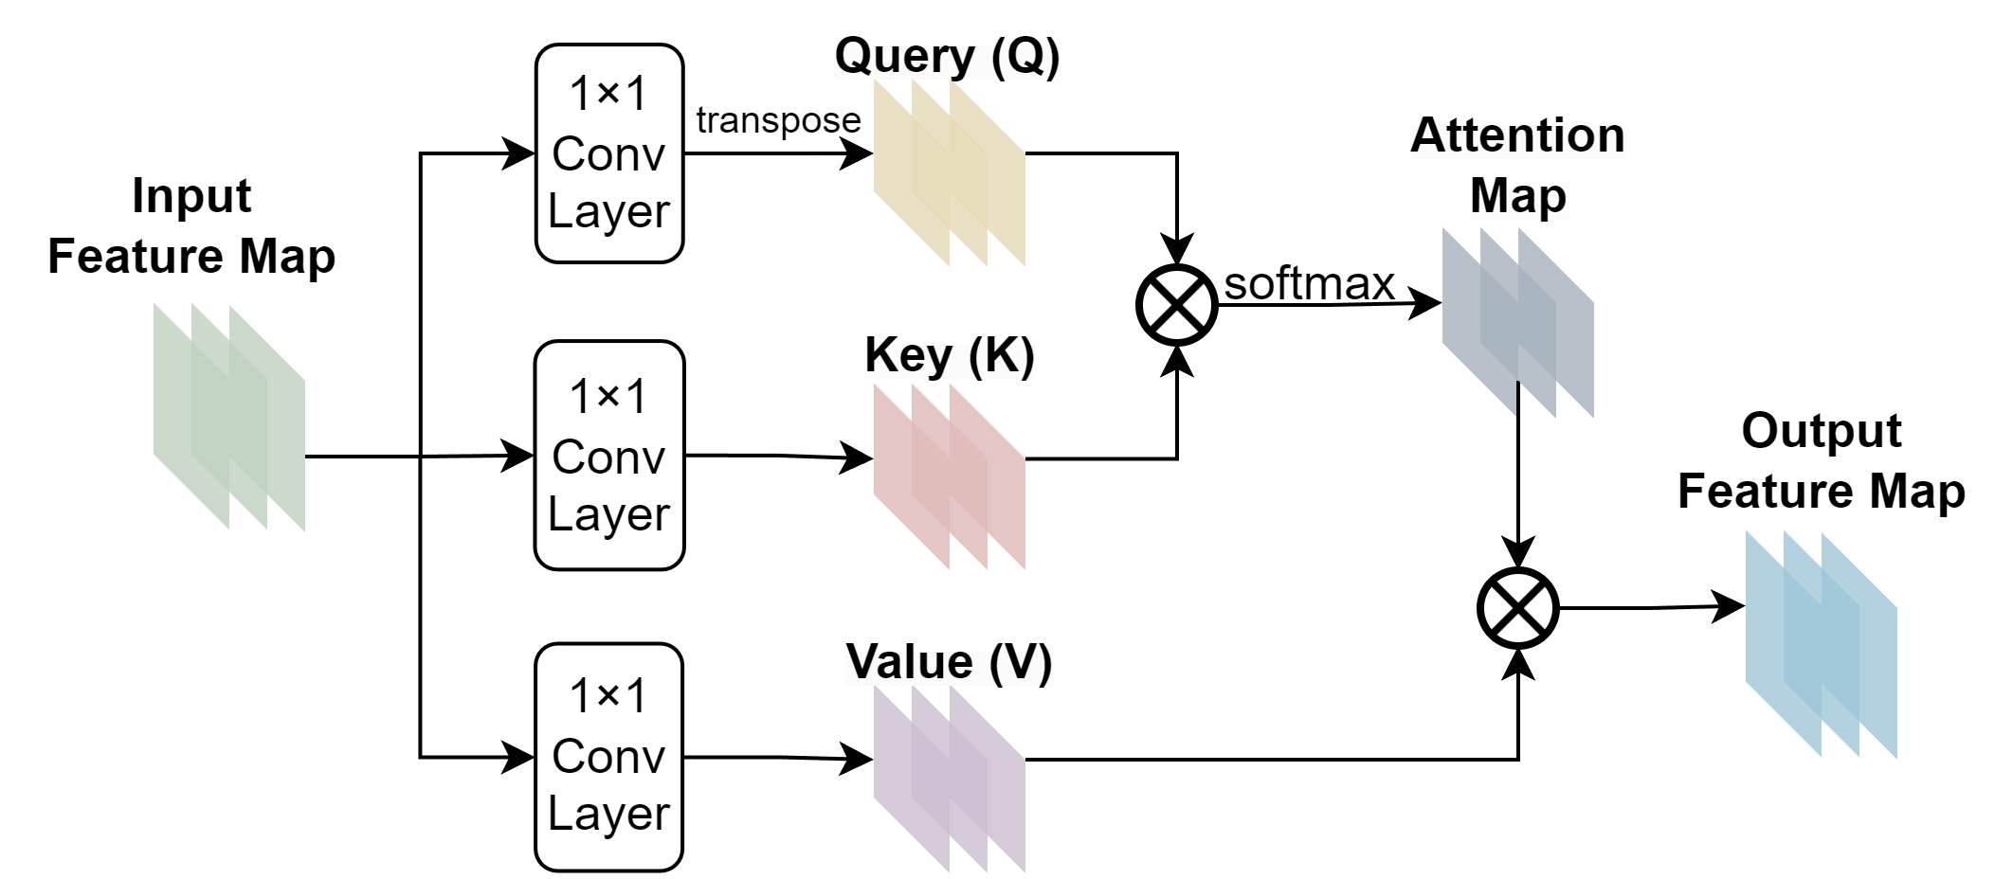
Residual Block:
Self-Attention Conv Block:

Slide 12
SAR Images Synthesized by GANs

Slide 13
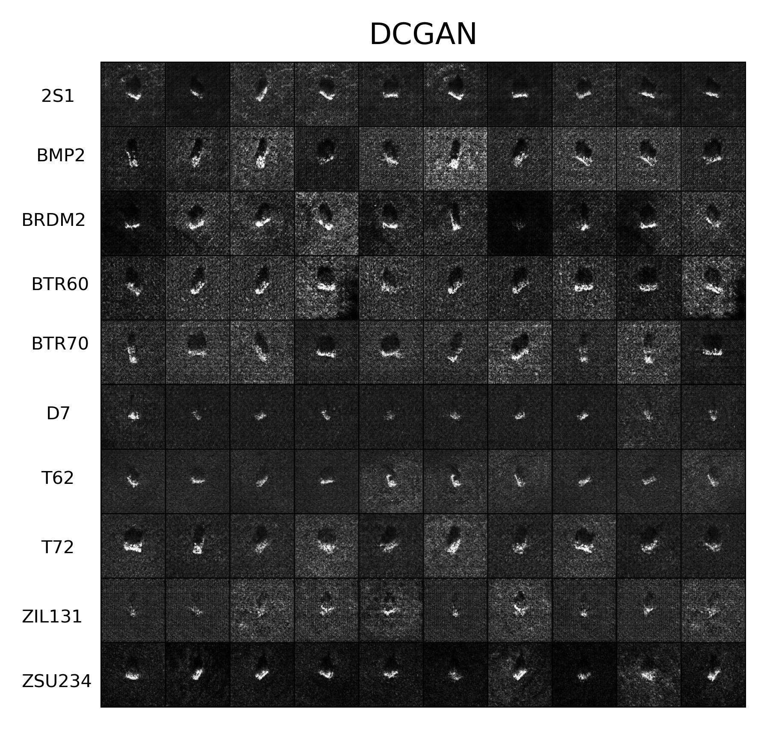
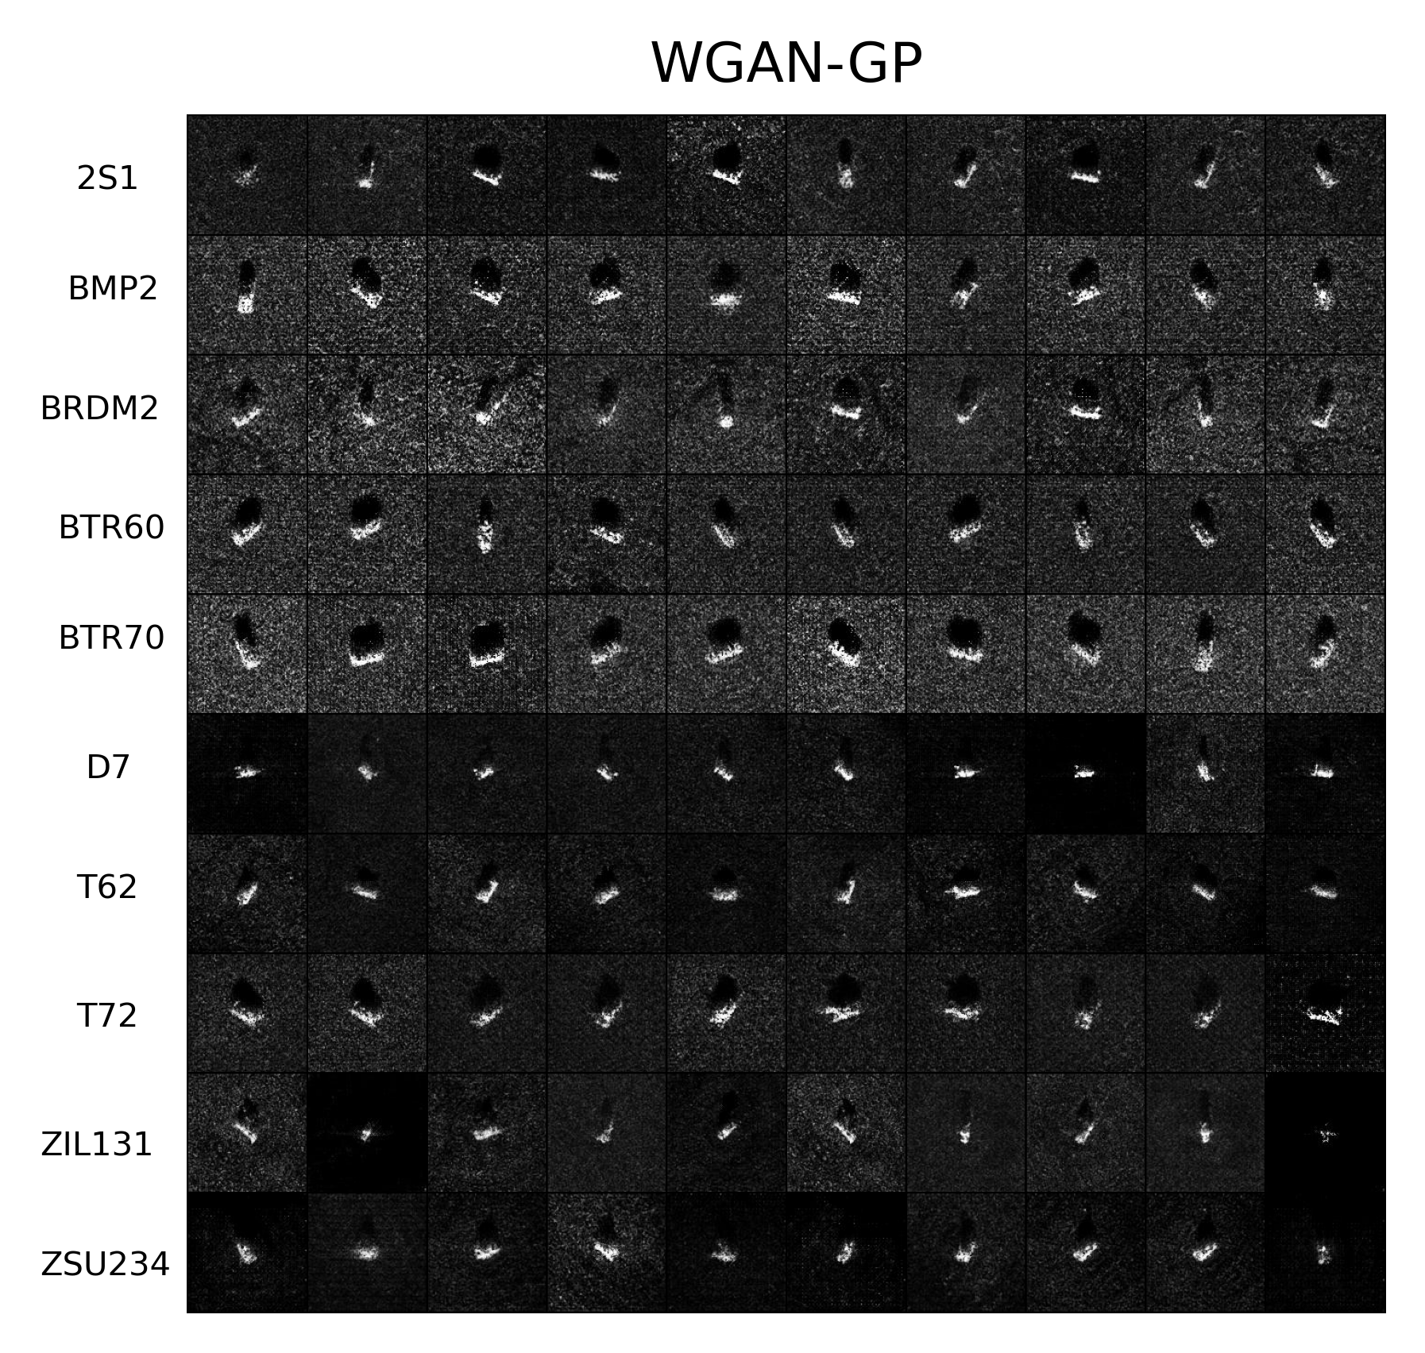

Slide 14
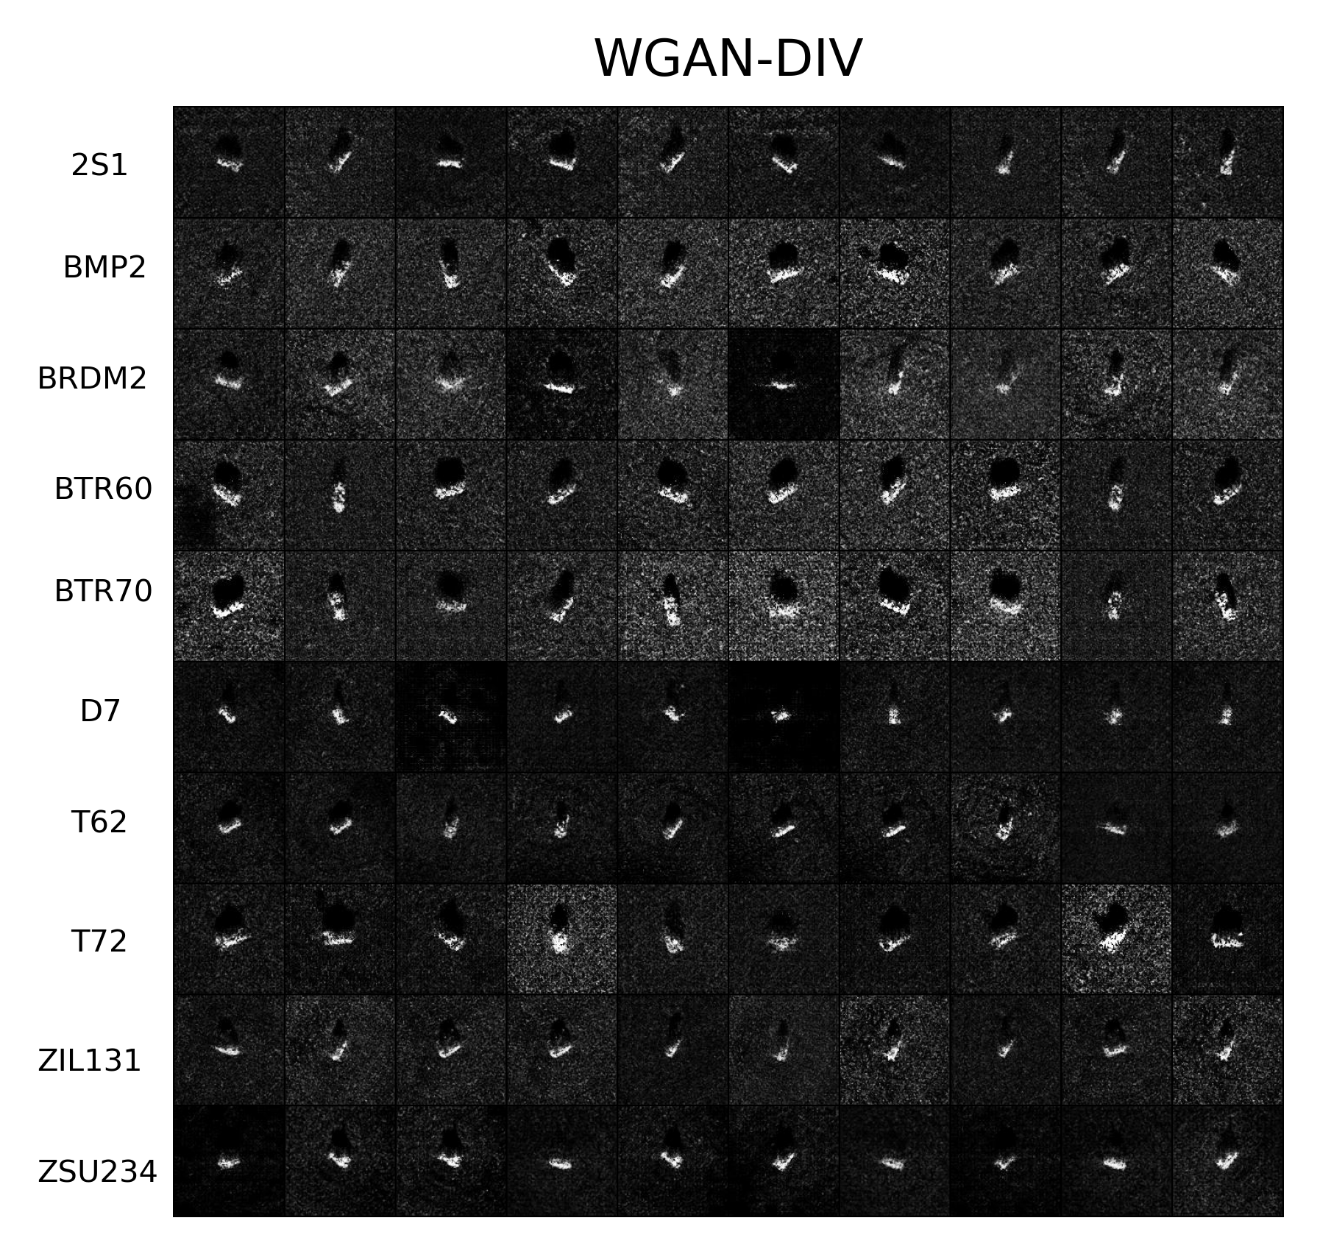
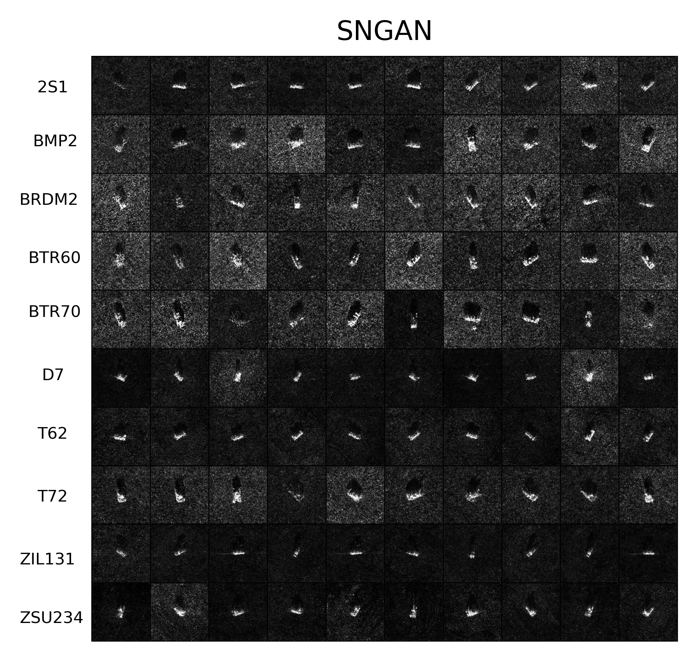

Slide 15
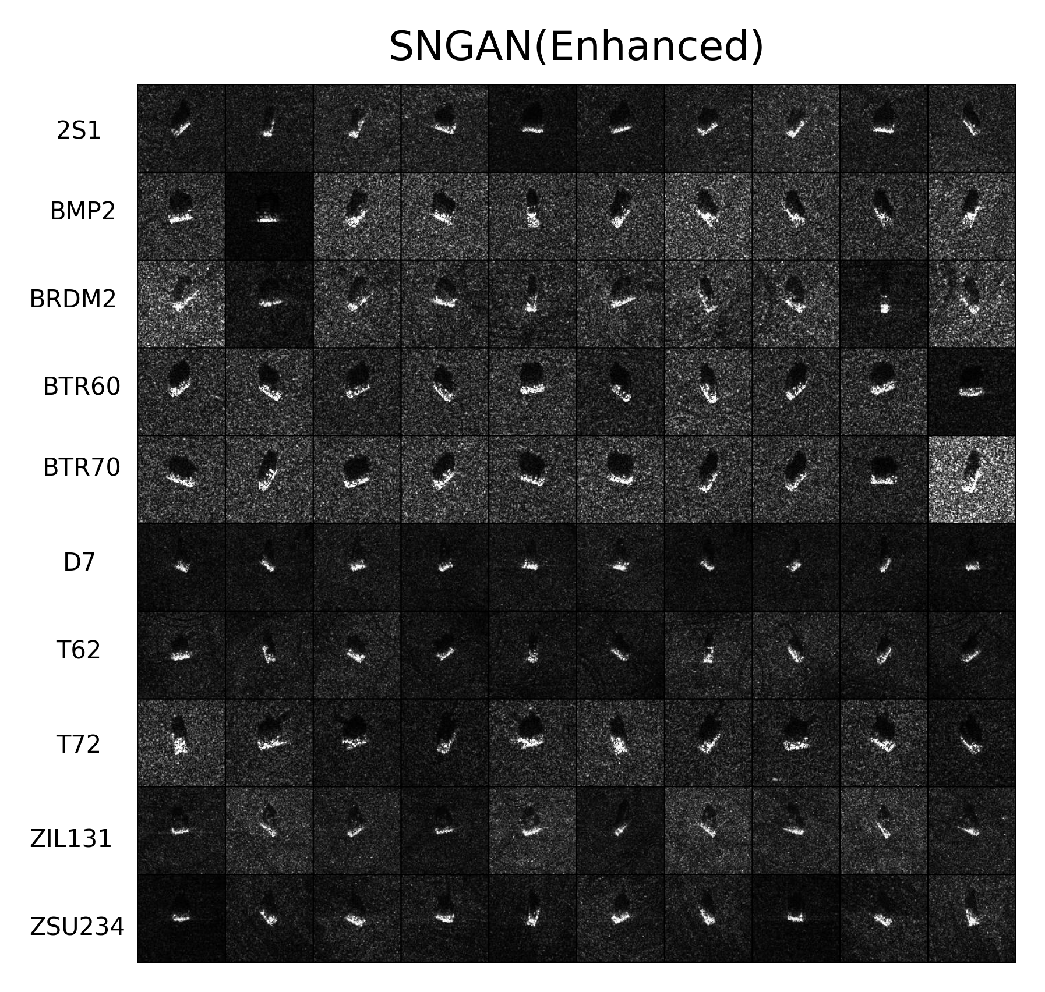
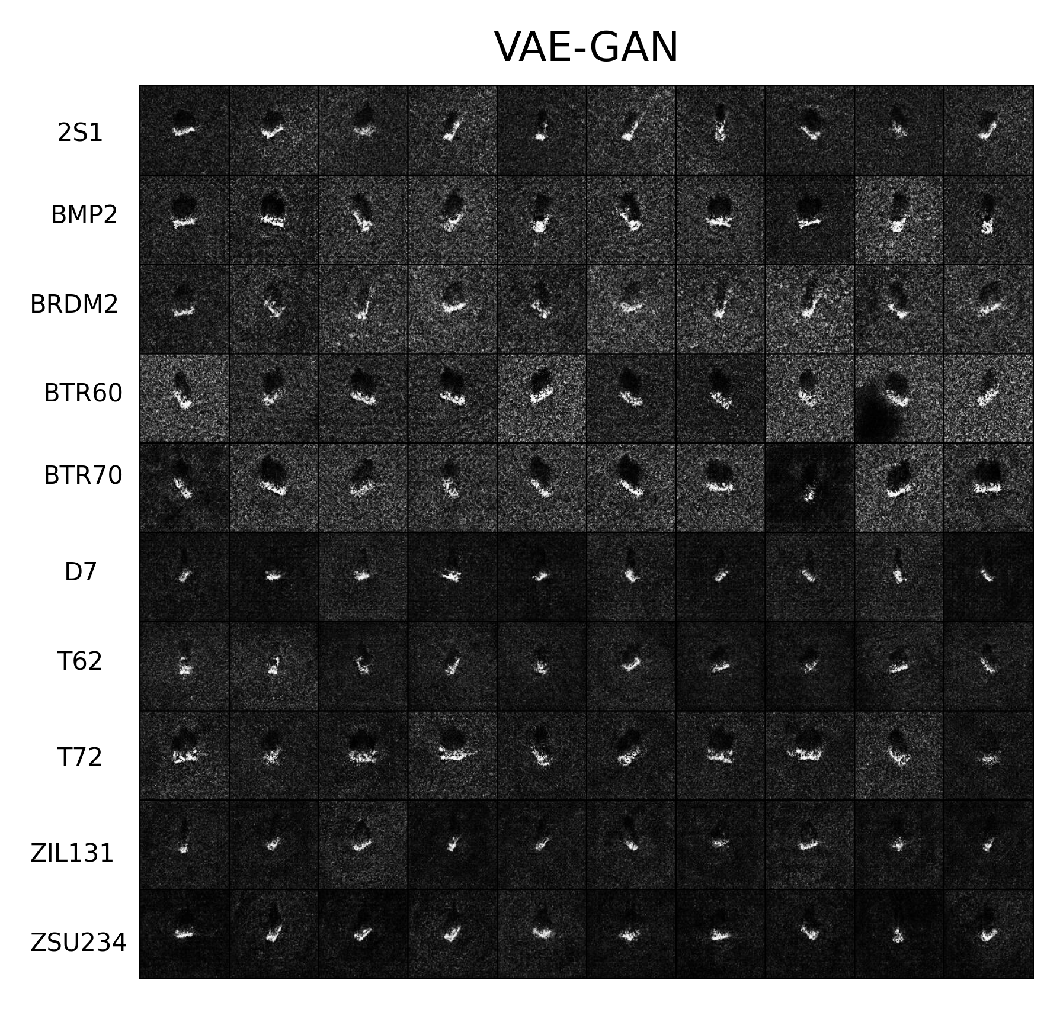

Slide 16
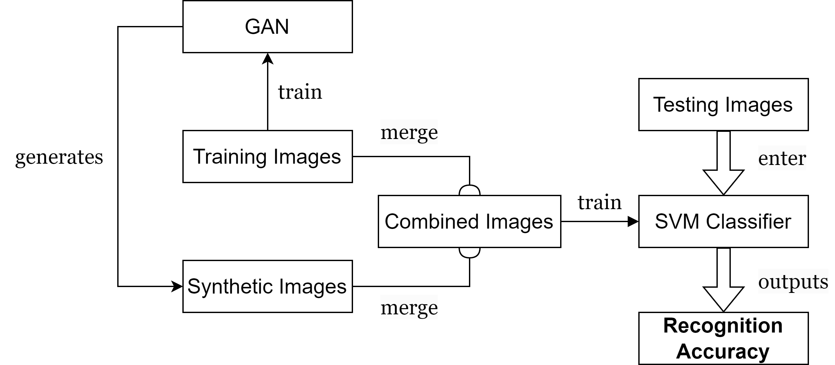
Performance Evaluation via Target Recognition
When training samples are extremely insufficient (10 images per class)

Slide 17
Performance Evaluation via Target Recognition
When training samples are extremely insufficient (10 images per class)
 | 0 | 10 | 20 | 30 | 40 | 50
DCGAN | 44.39% | - | - | - | - | -
WGAN-GP | 44.39% | 47.27% | 50.66% | 51.73% | 53.81% | 54.41%
WGAN-DIV | 44.39% | 47.94% | 51.35% | 52.34% | 54.44% | 55.32%
SNGAN | 44.39% | - | - | - | - | -
SNGAN (Enhanced) | 44.39% | 46.77% | 47.48% | 46.22% | 45.97% | 46.10%
VAE-GAN | 44.39% | 46.87% | 49.08% | 51.80% | 53.84% | 55.27%
Horizontal Axis: the number of synthetic images that are merged with real SAR samples per class
Vertical Axis: model name

Slide 18
Performance Evaluation via Target Recognition
When training samples are insufficient (50 images per class)
 | 0 | 50 | 100 | 150 | 200 | 250
DCGAN | 81.03% | - | - | - | - | -
WGAN-GP | 81.03% | 83.75% | 84.28% | 84.48% | 84.70% | 84.91%
WGAN-DIV | 81.03% | 83.96% | 84.49% | 84.88% | 84.94% | 85.20%
SNGAN | 81.03% | 83.02% | 83.15% | 84.20% | 84.29% | 84.61%
SNGAN (Enhanced) | 81.03% | 83.36% | 84.46% | 85.30% | 85.98% | 86.27%
VAE-GAN | 81.03% | 81.56% | 82.35% | 82.26% | 82.27% | 82.39%
Horizontal Axis: the number of synthetic images that are merged with real SAR samples per class
Vertical Axis: model name

Slide 19
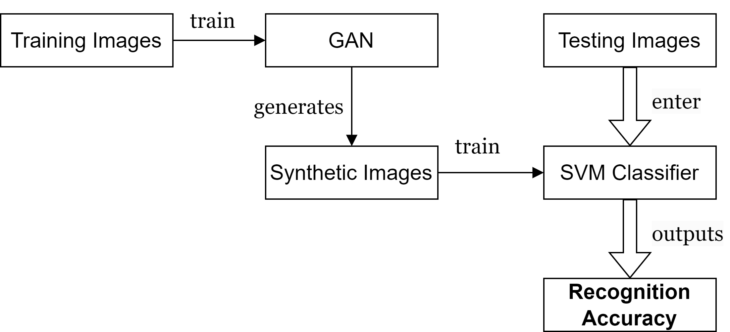
Performance Evaluation via Target Recognition
When training samples are relatively sufficient (use all training images in MSTAR)
Variety Test:
Model Name | Recognition Accuracy
DCGAN | 35.20%
WGAN-GP | 82.27%
WGAN-DIV | 77.99%
SNGAN | 83.05%
SNGAN (Enhanced) | 86.64%
VAE-GAN | 76.50%

Slide 20
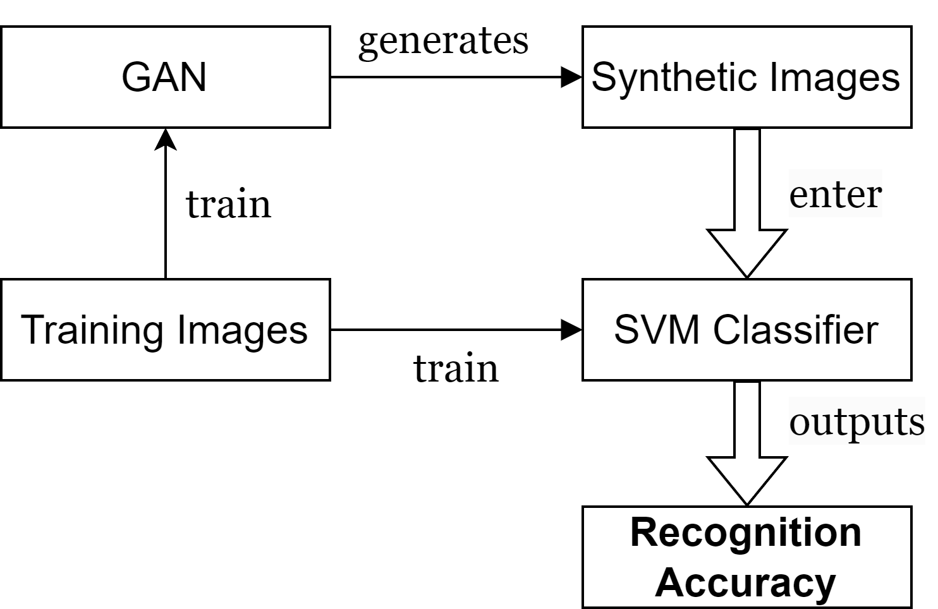
Performance Evaluation via Target Recognition
When training samples are relatively sufficient (use all training images in MSTAR)
Fidelity Test:
Model Name | Recognition Accuracy
DCGAN | 74.99%
WGAN-GP | 93.34%
WGAN-DIV | 96.40%
SNGAN | 94.33%
SNGAN (Enhanced) | 96.34%
VAE-GAN | 89.27%

Slide 21
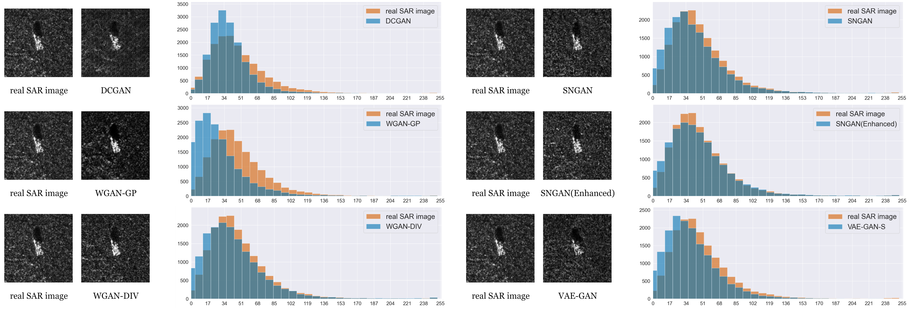
Performance Evaluation via Visual Effect and Statistics

Slide 22
Conclusions
Apart from DCGAN, other five GAN models are feasible for SAR image synthesis under certain conditions to achieve data augmentation
WGAN-DIV and SNGAN(Enhanced) are two of the effective choices:
WGAN-DIV performs well under all conditions and shows its excellence when the training samples is extremely insufficient. If considering time and computational costs of training, it is the best choice.
SNGAN(Enhanced) is the optimal option except when the training samples are extremely insufficient. The variety and fidelity of SNGAN(Enhanced)’s generated samples are satisfactory.

Slide 23
